Slide 1
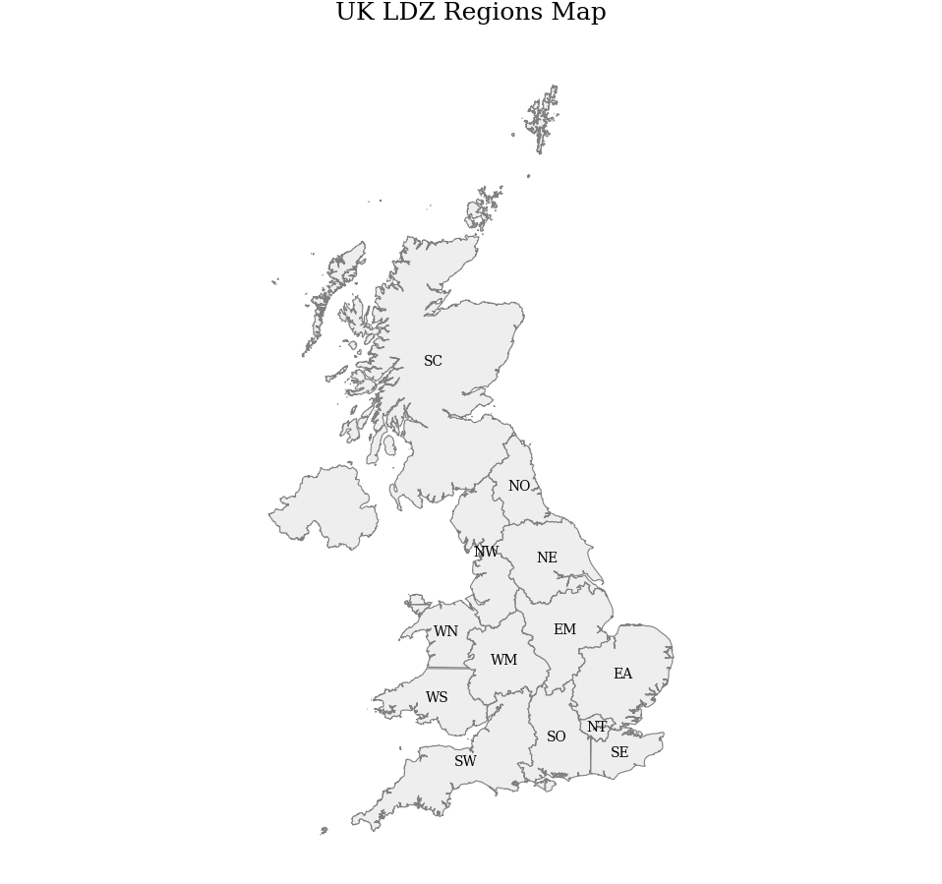
(a)
CO2 Exchange (Mton/ year)
(b)
CO2 Exchange (Mton/ year)
> 15
> 30
10- 15
15- 25
5-10
10- 15
1-5
5-10
< 1
1-5
< 1
NNS
NNS
27 Mt CO2eq
5 Mt CO2eq
EISB
EISB
42 Mt CO2eq
39 Mt CO2eq
SNS
SNS
62 Mt CO2eq
38 Mt CO2eq

